Slide 1
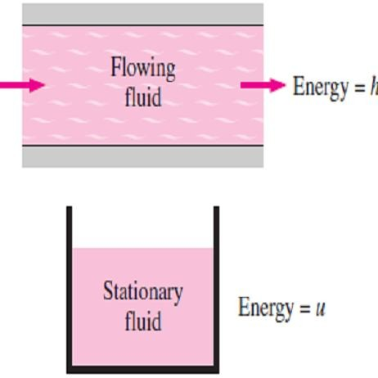
Chapter One Basics of Heat Transfer
1.1- Thermodynamics and Heat Transfer
The science of thermodynamics deals with the amount of heat transfer as a system undergoes a process from one equilibrium state to another, and makes no reference to how long the process will take. Whereas the science of heat transfer deals with the rate of heat transfer, which is the main quantity of interest in the design and evaluation of heat transfer equipment.
1.1.1- Heat and Other Forms of Energy
Energy can exist in numerous forms such as thermal, mechanical, kinetic, potential, electrical, magnetic, chemical, and nuclear, and their sum constitutes the total energy E or (e on a unit mass basis). The forms of energy related to the molecular structure of a system and the degree of the molecular activity are referred to as the microscopic energy. The sum of all microscopic forms of energy is called the internal energy of system, and is denoted U (or u on a unit mass basis).
Internal energy may be viewed as the sum of kinetic and potential energies of
the molecules. The portion of the internal energy of a system associated with the kinetic energy of the molecules is called sensible energy or sensible heat, where
the internal energy associated with the phase change of a system is called latent ^{Fig.(1.1) The internal}
energy or latent heat.
energy (u) represents
the microscopic energy
In the analysis of a system that involve fluid flow as shown in Fig.(1.1), a _{of a non-flowing fluid,}
combination of properties u and Pv is obtained to defined by a property called
whereas enthalpy (h) represents the microscopic energy of a flowing- fluid
enthalpy h, where; h=u+Pv and the term Pv represents the flow energy of the fluid
(also called the flow work).
1.1.2- Specific Heats of Gases, Liquids, and Solids
The ideal gas is defined as a gas that obeys the following relation;
Pv = RT , or; P =  RT ☹(1.1)
where P is the absolute pressure, v is the specific volume, T is the absolute temperature, ρ is the density, and R is the gas constant.
Note1- The specific heat is defined as the energy required to raise the temperature of a unit mass of a substance by one degree. In general, this energy depends on how the process is executed. In
thermodynamics, we are interested in two kinds of specific heats; specific heat at constant volume C_{v}
and specific heat at constant pressure C_{p}. For ideal gases, these two specific heats are related to each other by C_{p}= C_{v} + R, where the units of C_{p}, C_{v}, and R are [kJ/kg.K˚].
Note2- The change in internal energy and enthalpy can calculated for ideal gas by the following
relations;
Δu = C_{v} ΔT
or;
ΔU = mC_{v} ΔT
and Δh = C_{p} ΔT (J / g) ☹(1.2.a)
and ΔH = mC_{p} ΔT (J ) ☹(1.2.b)
where m is the mass of the system.
Note3- A substance whose specific volume (or density) does not change with temperature or pressure is called an incompressible substance. The specific volumes of solids and liquids generally remain constant during a process, and thus they can be approximated as incompressible substances, where the constant-volume and constant-pressure specific heats are identical for incompressible substances. Therefore, for solids and liquids we have; C_{p}≈C_{v}≈C, where C represents specific heat of the incompressible substances. Therefore, the change in the internal energy of solids and liquids can be expressed as;
ΔU = m C ΔT (J ) ☹ (1.3)

Slide 2
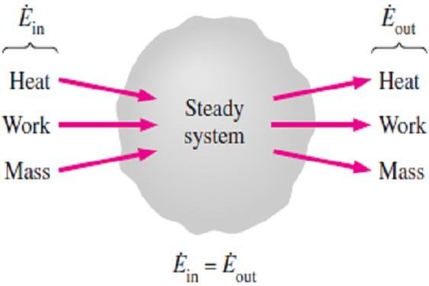
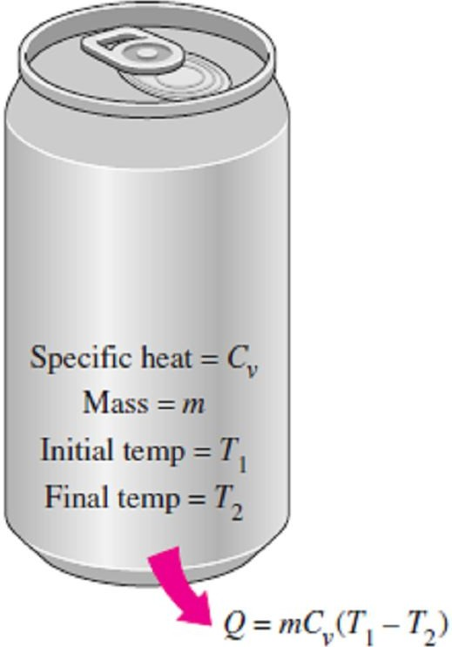
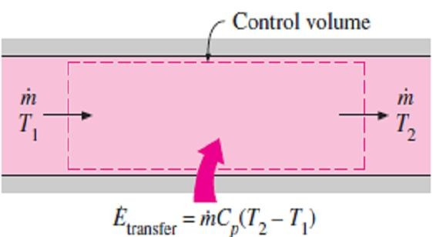
Chapter One Basics of Heat Transfer
1.1.3- The First Law of Thermodynamics
The first law of thermodynamics, also known as the conservation of energy principle or (the energy balance) which for any system undergoing any process may be expressed as follows: The net change (increase or decrease) in the total energy of the system during a process is equal to the difference between the total energy entering and the total energy leaving the system during that process, That is;
⎛
Total energy ⎞ ⎛ Total energy ⎞ ⎛ Change in the total ⎞
⎜
⎟ −⎜ ⎟ = ⎜ ⎟
☹(1.4)
⎝ entering the system⎠ ⎝leaving the system⎠ ⎝ energy of the system⎠
Noting that energy can be transferred to or from a system by heat, work, and mass flow, and that the total energy of a simple compressible system consists of internal, kinetic, and potential energies. So, the energy balance for any system undergoing any process can be expressed as;
^{E}in ^{− E}out
= ( J )
☹(1.5.a)

^{ΔE}system
Net energy transfer by heat, work, and mass
or, in the rate form, as;

Change in internal, kinetic, potential, etc., energies
Fig.(1.2) In steady operation, the rate of energy transfer to a system is equal to the rate of energy transfer from the system
^{E}in ^{− E}out
=
^{ΔE}system ^{/ dt}
(W ) ☹(1.5.b)


Rate of net energy transfer by heat, work, and mass
Rate of change in internal kinetic, potential, etc., energies
Note- The energy change of a system is zero (ΔE_{system} = 0) if the state of the system does not change during the process, that is, the process is steady. So, as shown in Fig.(1.2), the energy balance in this case reduces to;
^{E}in
= (W )
☹(1.6)

^{E}out
Rate of net energy transfer by heat, work, and mass

Rate of net energy transfer by heat, work, and mass
1.1.3.a- Energy Balance for Closed Systems (Fixed Mass)
For a closed system consists of a fixed mass, then the total energy E will consist of the internal energy U. This is especially the case for stationary systems since they don’t involve any changes in their velocity or elevation during a process. So, the energy balance relation for stationary closed system will be as follow;
E_{in} − E_{out} = ΔU = m C_{v} ΔT (J ) ☹(1.7.a)
when the system involves heat transfer only and no work interactions across
Fig.(1.3) In the absence of any work interactions, the change in the internal energy of a closed system is equal to the net heat transfer
its boundary as shown in Fig.(1.3), the energy balance relation further
reduces to;
Q = m C_{v} ΔT (J ) ☹(1.7.b)
where Q is the net amount of heat transfer to or from the system.
1.1.3.b- Energy Balance for Steady-Flow Systems
For a steady-flow system with one inlet and one exit, the rate of mass flow into the control volume must be equal to the rate of mass flow out of it,
thus, (m _{in} = m _{out} = m) . When the changes in kinetic and potential energies
are negligible, and there is no work interaction as shown in Fig.(1.4), the
energy balance for such a steady-flow system reduces to;
Fig.(1.4) The net rate of energy transfer to a fluid in a control volume is equal to the rate of increase in the energy of the fluid stream flowing through the control volume
Q = m Δh = m C_{p} ΔT (J / s = W ) ☹(1.8)
where Q is the rate of net heat transfer into or out of the control volume.

Slide 3
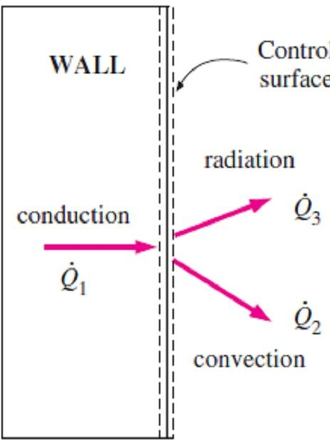
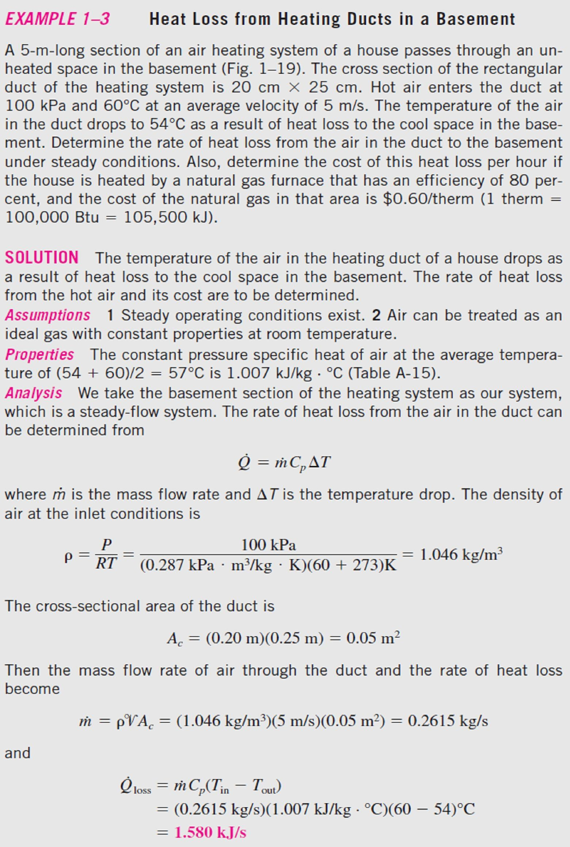
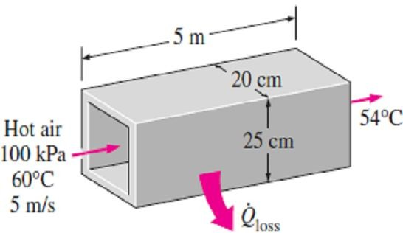
Chapter One Basics of Heat Transfer
1.1.4- Surface Energy Balance
A surface contains no volume or mass, and thus no energy. Therefore, a surface can be viewed as a fictitious system whose energy content remains constant during a process (just like a steady-state or steady-flow system). Then the energy balance for a surface can be expressed as;
^{E}in ^{= E}out
(W ) ☹(1.9)
This relation is valid for both steady and transient conditions, and the surface energy balance does not involve heat generation since a surface does not have a volume. For example, the energy balance for the outer surface of the wall in Fig.(1.5) can be expressed as; Q₁ = Q₂ + Q₃
1.1-
Fig.(1.5) Energy interactions at the outer wall surface of a house
as in Fig.(1.6).
Fig.(1.6) Schematic for Example-1.1

Slide 4
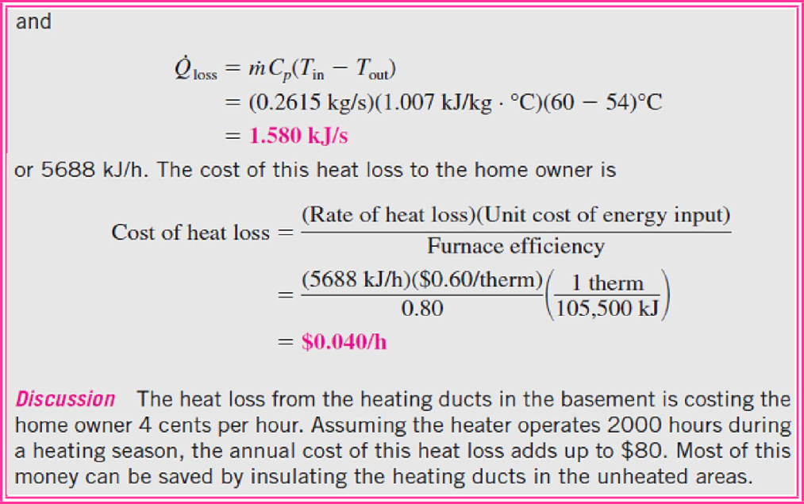
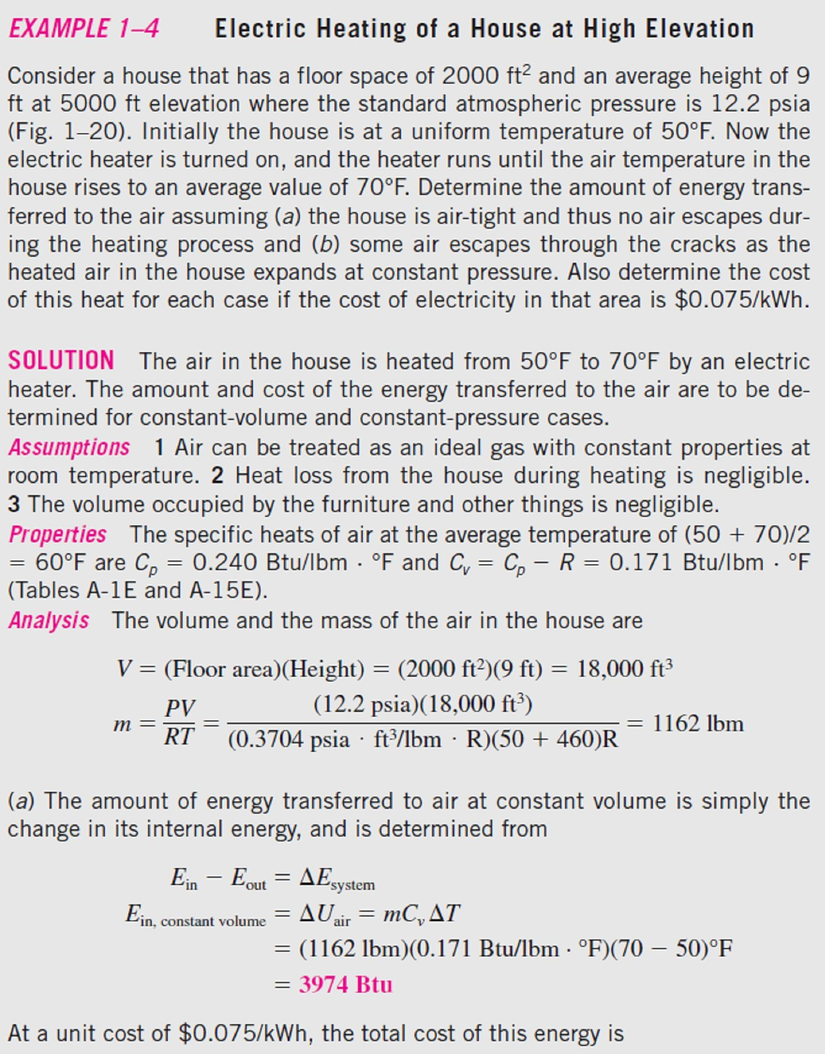
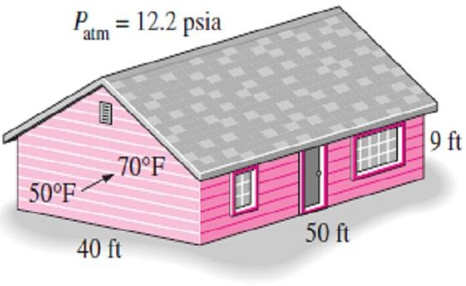
Chapter One
Basics of Heat Transfer
1.2-
as in Fig.(1.7).
Fig.(1.7) Schematic for Example-1.2

Slide 5
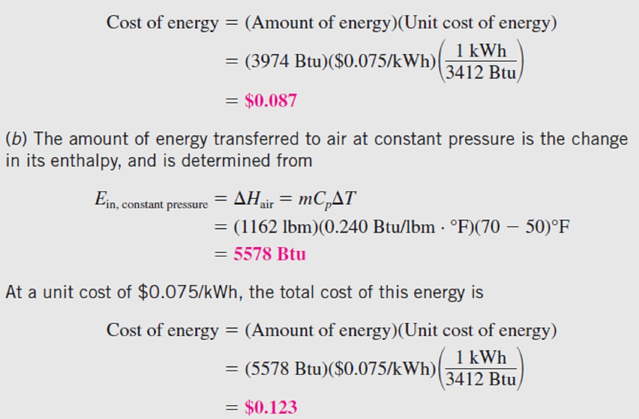
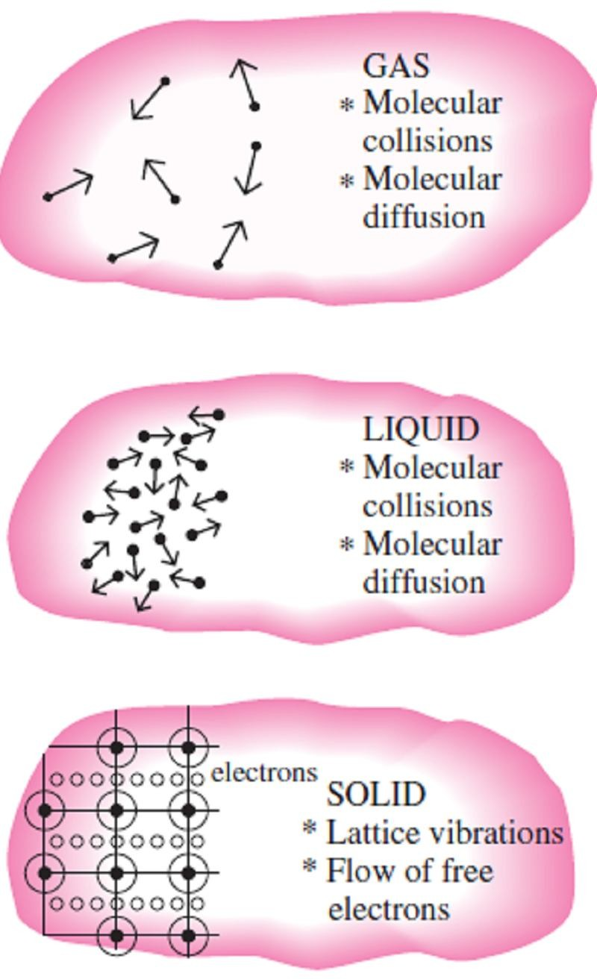
Chapter One
Basics of Heat Transfer
1.2- Heat Transfer Modes
The heat is defined as the form of energy that can be transferred from one system to another as a result of temperature difference. The science that deals with the determination of the rates of such energy transfers is the heat transfer. The transfer of energy as heat is always from the higher- temperature medium to the lower-temperature one, and heat transfer stops when the two mediums reach the same temperature. Heat can be transferred in three different modes: conduction, convection, and radiation. All modes of heat transfer require the existence of a temperature difference, and all modes are from the high-temperature medium to a lower-temperature one.
1.2.1- Conduction
Conduction is the transfer of energy from the more energetic particles of a substance to the adjacent less energetic ones as a result of interactions between the particles. Conduction can take place in solids, liquids, or gases. In solids, conduction is due to the combination of vibrations of the molecules in a lattice and the energy transport by free electrons, while in gases and liquids, it is due to the collisions and diffusion of the molecules during their random motion, as shown in Fig.(1.8).
The rate of heat conduction through a medium depends on the geometry of the medium, its thickness, and the material
of the medium, as well as the temperature difference across
the medium.
Experiments have shown that the rate of heat transfer Q through the wall will increase when the temperature difference (ΔT) across the wall or the area (A) normal to the direction of heat transfer increases, while it will decrease with the increase of the wall thickness (L). Thus we conclude that the rate of heat conduction through a plane layer is directly proportional to the temperature difference across the layer ΔT and the heat transfer area A, but is inversely proportional to the thickness of the layer L. Thus;
_{Rateof heat conduction∝} ( Area)(Temperature difference)
Fig.(1.8) The mechanisms of heat conduction in different phases of a substance
Thickness

Slide 6
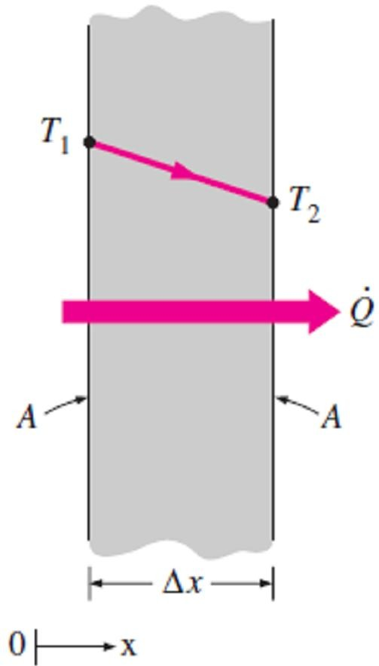
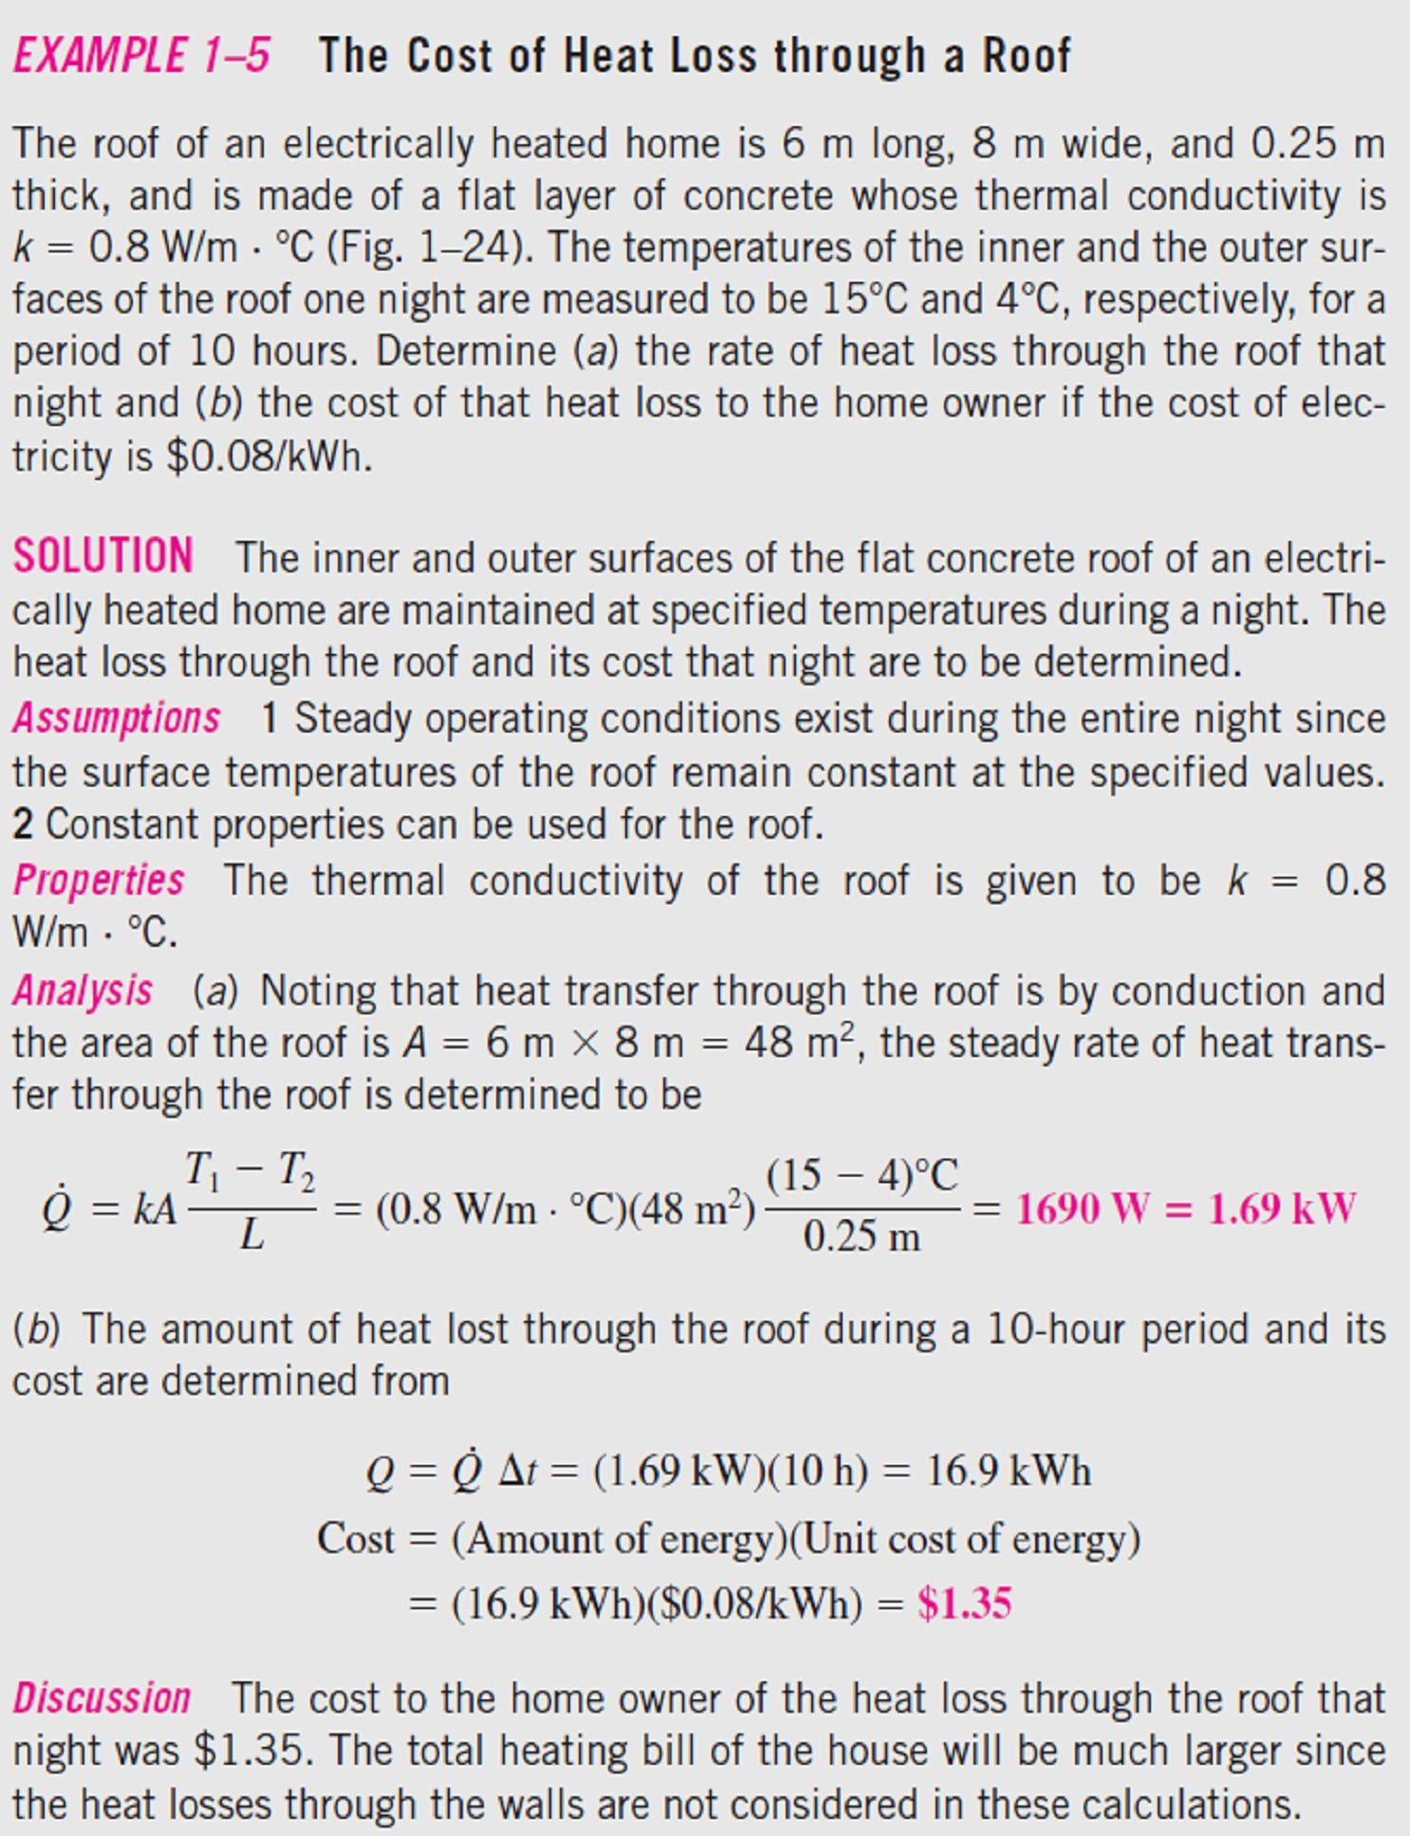
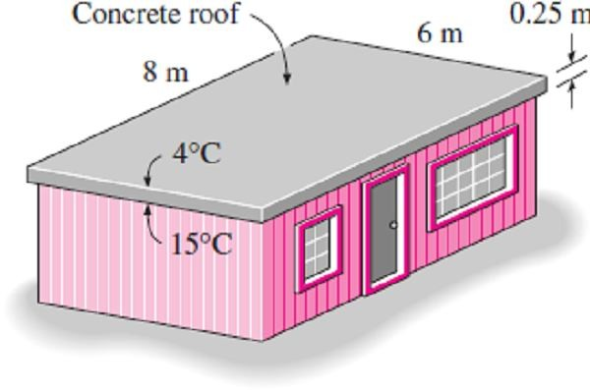
Chapter One
Basics of Heat Transfer
If we consider steady heat conduction through a large plane wall of thickness Δx = L and area A, as shown in Fig.(1.9), where the temperature difference across the wall is ΔT = T₂ – T₁, so, the rate of heat conduction will be;
•
T₁ − T₂ ΔT
Δx
^{Q}Cond . ^{= k A}
= −k A _{Δx} (W ) ☹☹(1.10)
where the constant of proportionality k is the thermal conductivity of the material, which is a measure of the ability of a material to conduct heat. In the limiting case of Δx→0, the equation above reduces to the differential form as follow;
dT
Q_{Cond .} = −k A _{dx} (W ) ☹☹(1.11)
which is called Fourier’s law of heat conduction. Here dT/dx is the temperature gradient, which is (the rate of change of T with x) at location x.
Fig. (1.9) Heat conduction through a large plane wall of thickness Δx and area A
1.3-
, Fig.(1.10).
Fig.(1.10) Schematic for Example-1.3

Slide 7
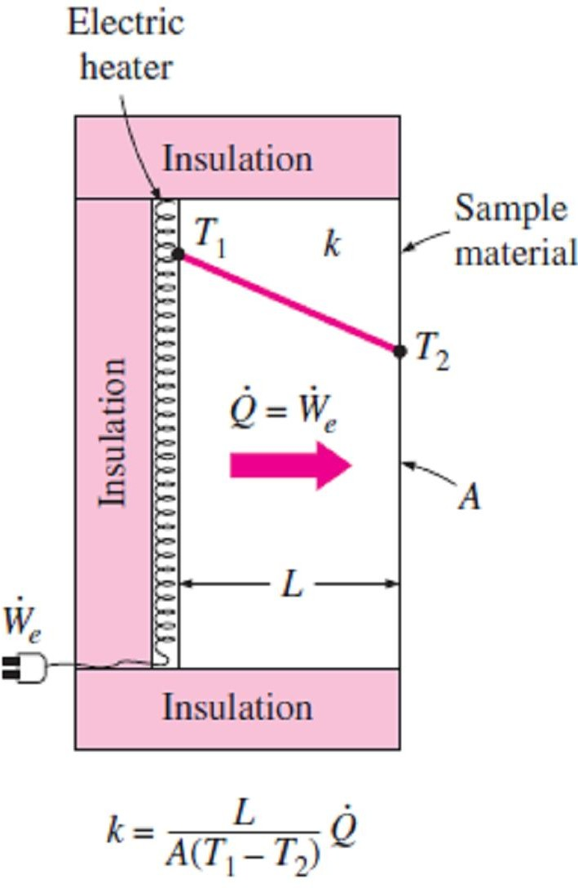
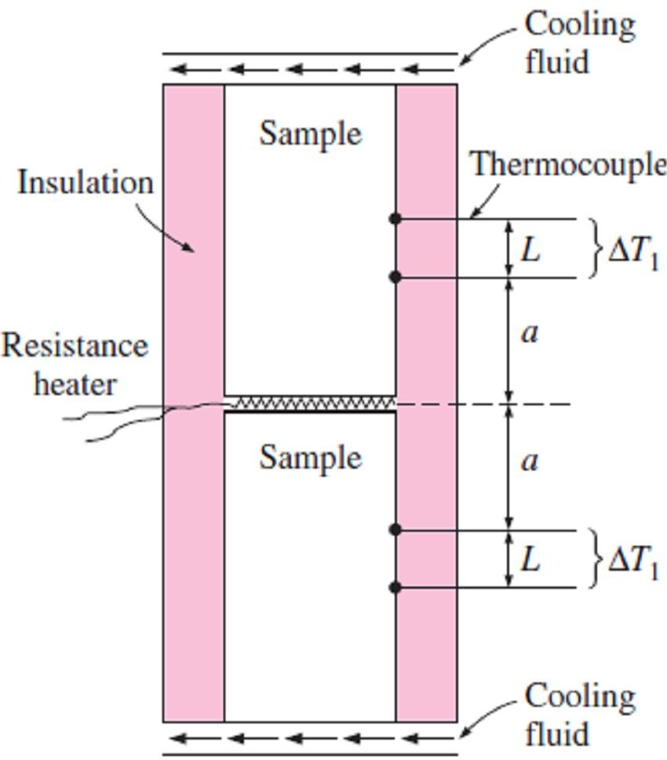
Chapter One
Basics of Heat Transfer
1.2.1.a- Thermal Conductivity
The thermal conductivity of a material can be defined as the rate of heat transfer through a unit thickness of the material per unit area per unit temperature difference, where the thermal conductivity of a material is a measure of the ability of the material to conduct heat.
Note:- To measure thermal conductivity of a certain material, we can follow the simple experimental setup which is shown in Fig.(1.11), where a layer of material of known thickness L and area A can be heated from one side by an electric resistance heater of known output Q˙. If the outer surfaces of the heater are well insulated, all the heat generated by the resistance heater will be transferred through the material whose conductivity is to be determined. Then measuring the two surface temperatures of the material when steady heat transfer is reached and substituting them into Eq.(1.10) together with other known quantities give the value of thermal conductivity.
Fig. (1.11) A simple experimental setup to determine the thermal conductivity of a material
EXAMPLE 1.4-
A common way of measuring the thermal conductivity of a material is to sandwich an electric thermo-foil heater between two identical samples of the material, as shown in Fig.(1.12), a circulating fluid such as tap water keeps the exposed ends of the samples at constant temperature. The lateral surfaces of the samples are well insulated to ensure that heat transfer through the samples is one-dimensional. In a certain experiment, cylindrical samples of diameter 5cm and length 10cm are used. The two thermocouples in each sample are placed 3cm apart. After initial transients, the electric heater is observed to draw 0.4A at 110V, and both differential thermometers read a temperature difference of 15C°, Determine the thermal conductivity of the sample.
SOLUTION
Assumptions 1 Steady operating conditions exist since the temperature readings do not change with time. 2 Heat losses through the lateral surfaces of the apparatus are negligible since those surfaces are well insulated, and thus, the entire heat generated by the heater is conducted through the samples. 3 The apparatus possesses thermal symmetry.
Analysis The electrical power consumed by the resistance heater and converted to heat is;
P=V×I=(110V)×(0.4A)=44W
The rate of heat flow through each sample is; Q˙=P/2=22W
The area normal to the direction of heat flow is; A=πD²/4=π(0.05m)²/4=0.00196 m²
Q˙=k A ΔT/L
k= Q˙ L/( A ΔT)=(22W)(0.03m)/[( 0.00196 m²)(15C°)
=22.4 W/m C°
Fig.(1.12) Schematic for Example-1.4

Slide 8
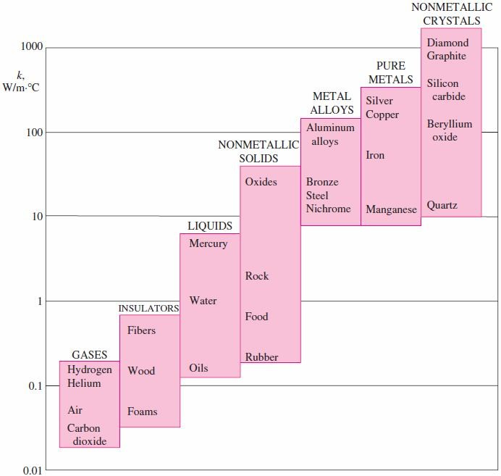
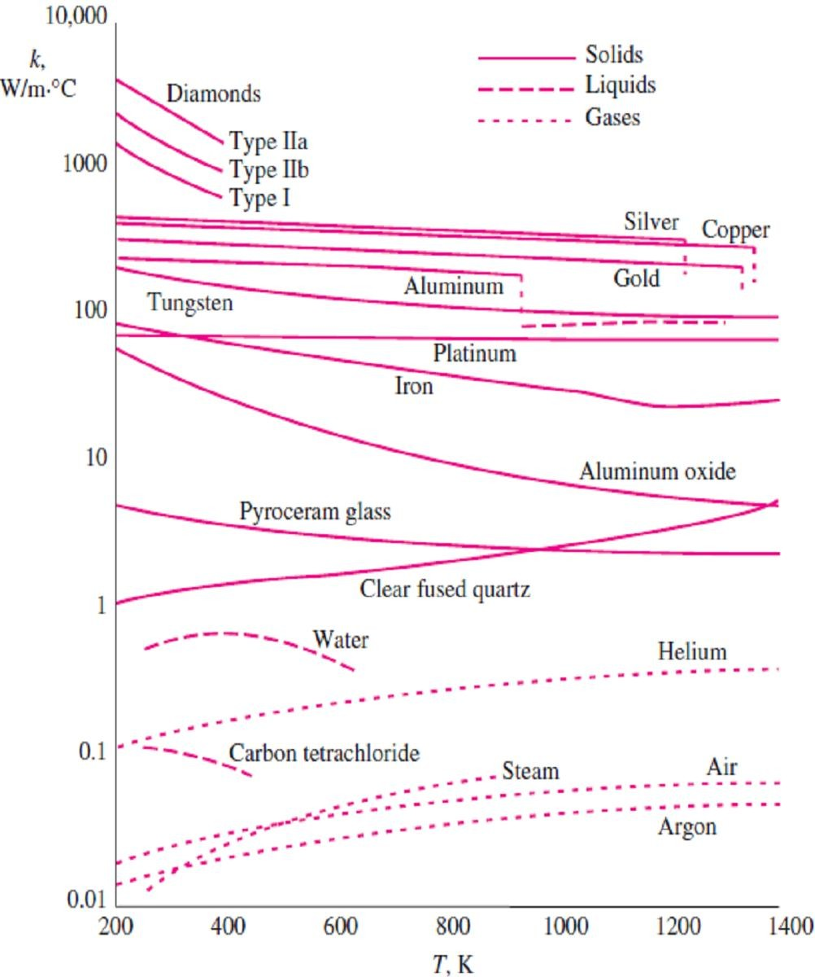
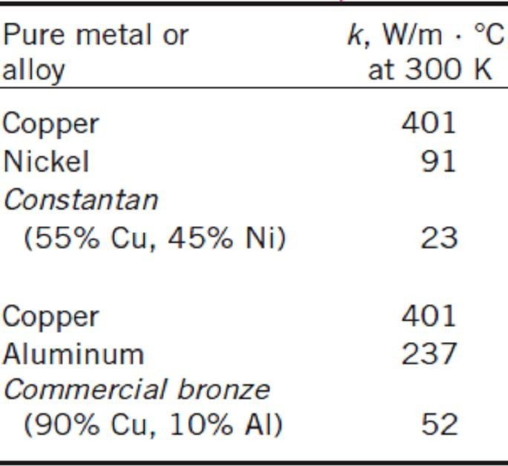
Chapter One Basics of Heat Transfer
Note1- The thermal conductivities of materials vary over a wide range, as shown in Fig.(1.13). The thermal conductivities of gases such as air vary by a factor of 10⁴ from those of pure metals such as copper. Note that pure crystals and metals have the highest thermal conductivities, and gases and insulating materials the lowest.
Note2- The thermal conductivity of an alloy of two metals is usually much lower than that of either
metal, as shown in Table (1.1). For example, the thermal conductivity of steel containing just 1% of chrome is 62 W/m·C°, while the thermal conductivities of iron and chromium are 83 and 95 W/m·C°, respectively.
Note3- The thermal conductivities of materials vary with temperature, where the variation of thermal conductivity over certain temperature ranges is negligible for some materials, but significant for others, as shown in Fig.(1.14).
Fig. (1.13) The range of thermal conductivity of various materials at room temperature
Fig. (1.14) The variation of the thermal conductivity of various solids, liquids, and gases with temperature
Table (1.1) The thermal conductivity of
an alloy is usually much lower than the
thermal conductivity of its components

Slide 9
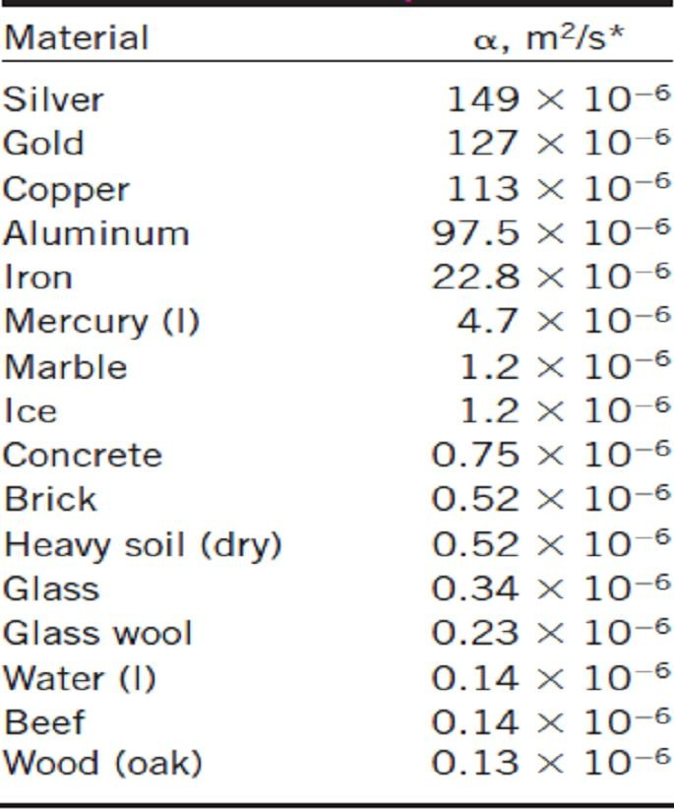
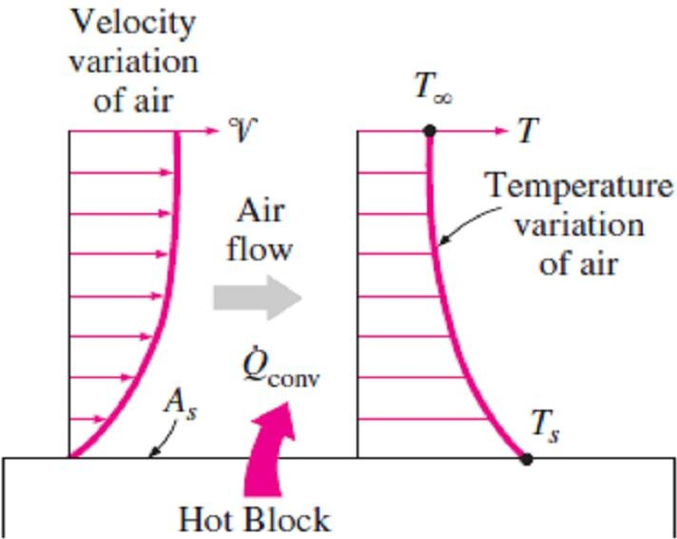
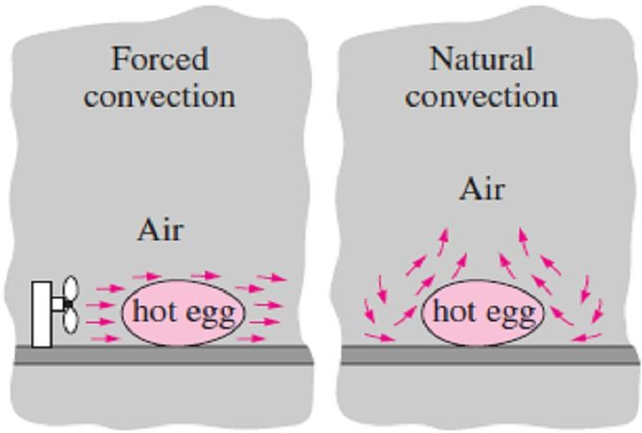
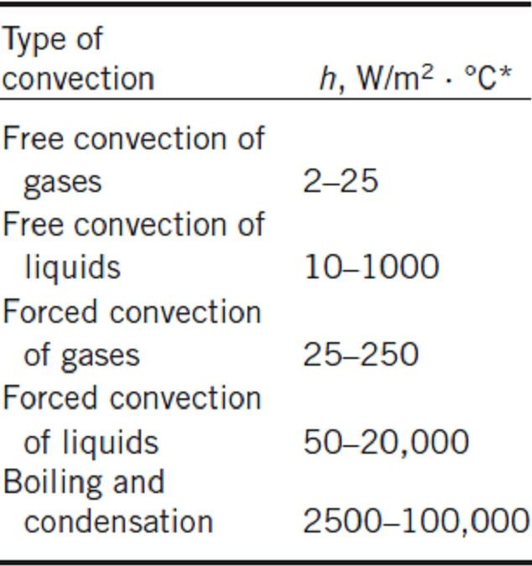
Chapter One
Basics of Heat Transfer
1.2.1.b- Thermal Diffusivity The product ρC_{p}, which is frequently encountered in heat transfer analysis, is called the heat capacity of a material and represents the heat storage capability of a material. Another material property that appears in the transient heat conduction analysis is the thermal diffusivity, which represents how fast heat diffuses through a material and is defined as; _{ =} Heat Conducted ₌ k _{(m2 / s) ☹(1.12)} Heat Stored  C_{p} The thermal diffusivities of some common materials at 20 C° are given in Table (1.2). Note- The thermal conductivity k represents how well a material conducts heat, and the heat capacity ρC_{p} represents how much energy a material stores per unit volume. Therefore, the thermal diffusivity of a material can be viewed as the ratio of the heat conducted through the material to the heat stored per unit volume. 1.2.2- Convection Convection is the mode of energy transfer between a solid surface and the adjacent liquid or gas that is in motion, and it involves the combined effects of conduction and fluid motion. The faster the fluid motion, the greater the convection heat transfer. In the absence of any bulk fluid motion, heat transfer between a solid surface and the adjacent fluid is by pure conduction. Consider the cooling of a hot block by blowing cool air over its top surface as shown in Fig. (1.15). Energy is first transferred to the air layer adjacent to the block by conduction, this energy is then carried away from the surface by convection. Note1- Convection is called forced convection if the fluid is forced to flow over the surface by external means such as a fan, pump, or the wind. In contrast, convection is called natural or (free) convection if the fluid motion is caused by buoyancy forces that are induced by density differences due to the variation of temperature in the fluid Fig.(1.16). Note2- The rate of convection heat transfer is observed to be proportional to the temperature difference, and is conveniently expressed by Newton’s law of cooling as; Q_{Conv.} = h A_{s} (T_{s} − T∞ ) (W ) ☹☹(1.13) where h is the convection heat transfer coefficient in W/m²·C° or Btu/h·ft²·F°, A_{s} is the surface area through which convection heat transfer takes place, T_{s} is the surface temperature, and T∞ is the temperature of the fluid sufficiently far from the surface. Note3- The convection heat transfer coefficient h is not a property of the fluid. It is an experimentally determined parameter whose value depends on all the variables influencing convection such as the surface geometry, the nature of fluid motion, the properties of the fluid, and the bulk fluid velocity. Typical values of h are given in Table (1.3). |  | Table (1.2) The thermal diffusivities of some materials at room temperature
 | Fig. (1.15) Heat transfer from a hot surface to air by convection Fig. (1.16) Heat transfer from a hot surface to air by convection Table (1.3) Typical values of convection heat transfer coefficient

Slide 10
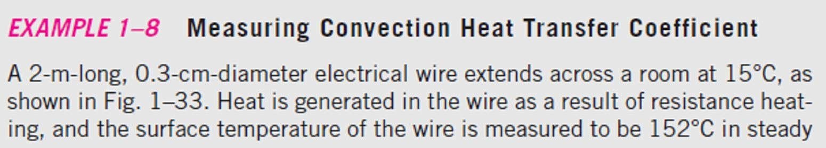
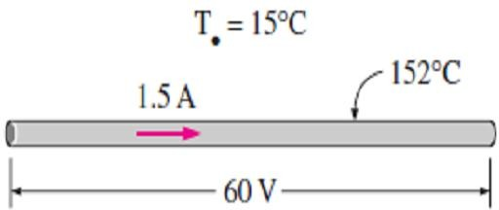
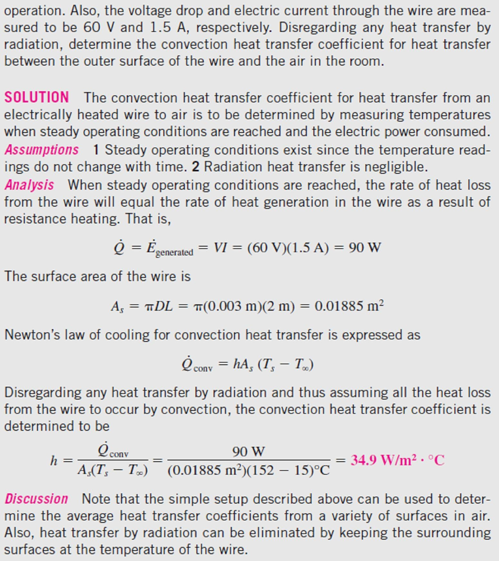
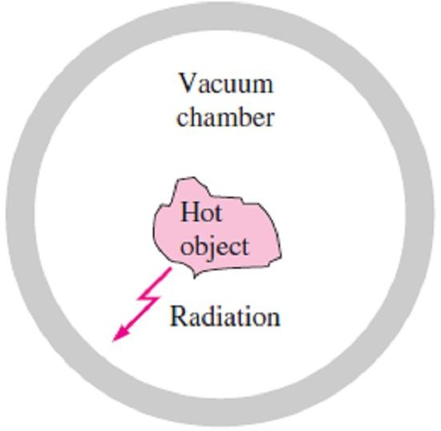
Chapter One
Basics of Heat Transfer
1.5-
Fig.(1.17).
Fig.(1.17) Schematic for Example-1.5
1.2.3- Radiation
Radiation is the energy emitted by a body in the form of electromagnetic waves as a result of the changes in the electronic configurations of the atoms or molecules. Unlike conduction and convection, the transfer of energy by radiation does not require the presence of a material medium to take place as shown in Fig.(1.18). In fact, energy transfer by radiation is faster than it by conduction or convection since it transfers at the speed of light. All bodies at a temperature above absolute zero emit thermal radiation, where the maximum rate of radiation that can be emitted from a surface at an absolute temperature T₁ in (K) to another surface at an absolute temperature T₂ is given by the Stefan–Boltzmann law as;
Q =   A (T ⁴ − T ⁴ ) (W ) ☹(1.14)
rad._{max} 1 s1 1 2
where σ = 5.67 ×10⁻⁸ (W/m² · K° ⁴) is the Stefan–Boltzmann constant, while ε₁ and A_{s1} are the emissivity and surface area of the first radiative body, respectively.
Fig.(1.18) A hot object in a vacuum chamber loses heat by radiation only

Slide 11
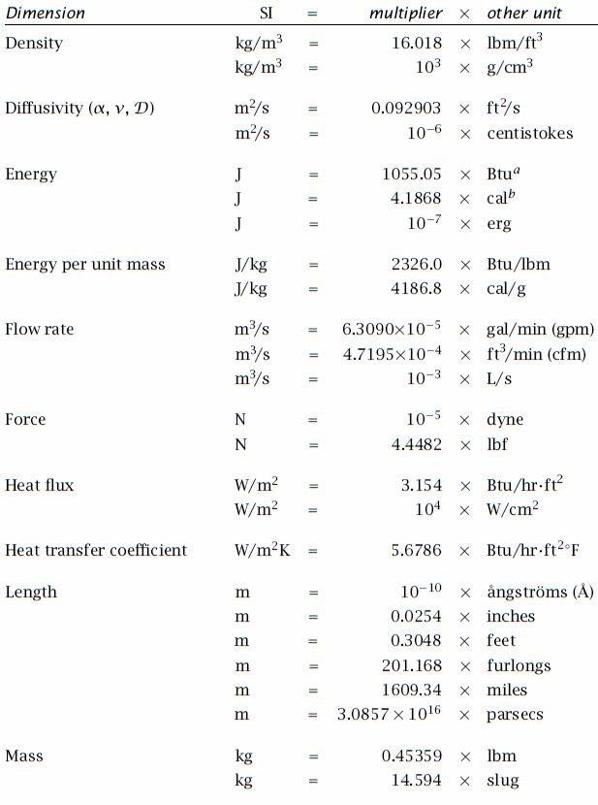
Chapter One Basics of Heat Transfer
1.3- Units and Conversion Factors
Generally, all the engineering branches use the system of S.I. units mainly, but the need to deal with English units will remain with us for many of next years. We therefore list some conversion factors from English units to S.I. units as shown in Table(1.4) which provides multipliers for a selection of common units. As an example of their use, we may convert a power of (1,000 Btu/hr) into
(W) by using the given multiplier;
1,000 Btu/hr × [0.29307 W/(Btu/hr)] ≈ 293.1 W
Note- The S.I. units may have prefixes placed front of them to indicate multiplication by various powers of ten. For example, the prefix "k" denotes multiplication by 10³. The complete set of S.I. prefixes is given in Table(1.5).
Table (1.4) Selected Conversion Factors

Slide 12
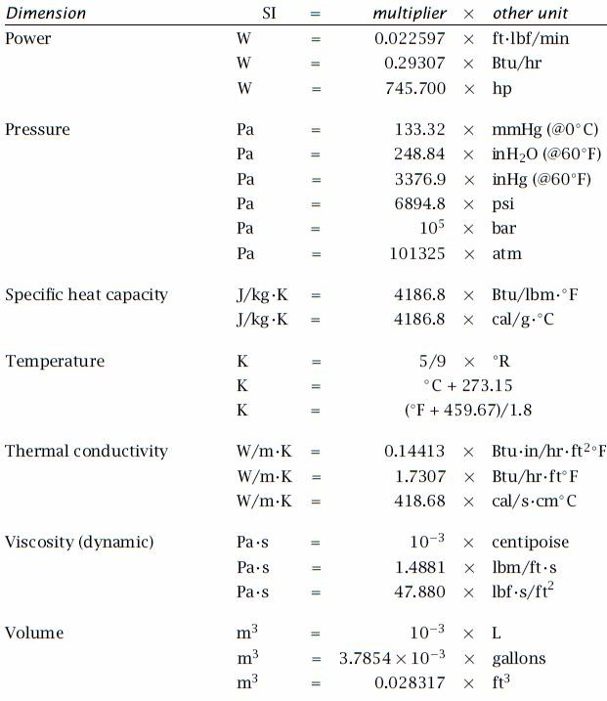
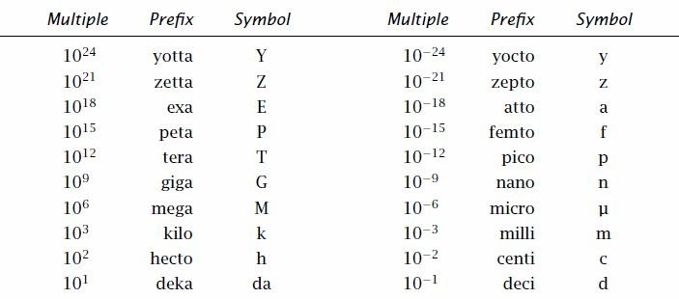
Chapter One Basics of Heat Transfer
Table (1.4) …continued
Table (1.5) S.I. Multiplying Factors

Slide 13
Chapter One
Basics of Heat Transfer
PROBLEMS
1.1- A cylindrical resistor element on a circuit board dissipates 0.6 W of power. The resistor is 1.5cm long, and has a diameter of 0.4cm. Assuming heat to be transferred uniformly from all surfaces, determine (a) the amount of heat this resistor dissipates during a 24-hour period, (b) the heat flux, and (c) the fraction of heat dissipated from the top and bottom surfaces.
Answers: 51.84 kJ, 0.2809 W/m², 11.8%
constant pressure. Also, determine the cost of this heat if the unit cost of electricity in that area is 0.075$/kWh. Answers: 9038 kJ, 0.19 $
1.5- Consider a 60-gallon water heater that is initially filled with water at 45F°. Determine how much energy needs to be transferred to the water to raise its temperature to 140F°. Take the density and specific heat of water to be 62 lbm/ft³ and 1.0 Btu/lbm ·F°, respectively.
Answer: 47,250 Btu 1.6- A 1m³ rigid tank contains hydrogen at 250kPa and 420K. The gas is now cooled until its temperature drops to 300K. Determine (a) the final pressure in the tank and (b) the amount of heat transfer from the tank.
Answers: 178.6 kPa, 180.0 kJ 1.7- A 20kg mass of iron at 100C° is brought into contact with 20kg of aluminum at 200C° in an
1.2- A 15-cm-diameter aluminum ball is to be heated from 80C° to an average temperature of 200C°. Taking the average density and specific heat of aluminum in this temperature range to be ρ=2700kg/m³ and C_{p}=0.90kJ/kg·C°, respectively, determine the amount of energy that needs to be transferred to the aluminum ball.
Answer: 515 kJ 1.3- Consider an electrically heated house that has a floor space of 200m² and an average height of 3m at 1000m elevation, where the standard atmospheric pressure is 89.6kPa. The house is maintained at a temperature of 22C°, and the infiltration losses are estimated to amount to 0.7 ACH. Assuming the pressure and the temperature in the house remain constant, determine the amount of energy loss from the house due to infiltration for a day during which the average outdoor temperature is 5C°. Also, determine the cost of this energy loss for that day if the unit cost of electricity in that area is 0.082$/kWh.
Hint- (Infiltration of cold air into a warm house
during winter through the cracks around doors, windows, and other openings is a major source of energy loss since the cold air that enters needs to be heated to the room temperature. The infiltration is often expressed in terms of ACH (air changes per hour). An ACH of 2 indicates that the entire air in the house is replaced twice every hour by the cold air outside).
Answers: 53.8 kWh/day, 4.41$/day 1.4- Consider a house with a floor space of 200m² and an average height of 3m at sea level, where the standard atmospheric pressure is 101.3kPa. Initially the house is at a uniform temperature of 10C°. Now the electric heater is turned on, and the heater runs until the air temperature in the house rises to an average value of 22C°. Determine how much heat is absorbed by the air assuming some air escapes through the cracks as the heated air in the house expands at
insulated enclosure. Determine the final
equilibrium temperature of the combined system.
Answer: 168C°
1.8- An unknown mass of iron at 90C° is dropped into an insulated tank that contains 80L of water at 20C°. At the same time, a paddle wheel driven by a 200W motor is activated to stir the water. Thermal equilibrium is established after 25 minutes with a final temperature of 27C°. By neglecting the energy stored in the paddle wheel, determine the mass of the iron.
Answer: 72.1kg 1.9- A 90 lbm mass of copper at 160F° and a 50 lbm mass of iron at 200F° are dropped into a tank containing 180 lbm of water at 70F°. If 600 Btu of heat is lost to the surroundings during the
process, determine the final equilibrium
temperature. Answer: 74.3F°
1.10- The inner and outer surfaces of a 5m×6m brick wall of thickness 30cm and thermal conductivity 0.69 W/m ·C° are maintained at temperatures of 20C° and 5C°, respectively. Determine the rate of heat transfer through the wall, in W. Answer: 1035 W
1.11- The inner and outer surfaces of a 0.5cm- thick 2m×2m window glass in winter are 10C° and 3C°, respectively. If the thermal conductivity of the glass is 0.78 W/m ·C°, determine the amount of heat loss, in kJ, through the glass over a period of 5 hours. What would your answer be if the glass were 1cm-thick?
Answers: 78,624 kJ, 39,312 kJ

Slide 14
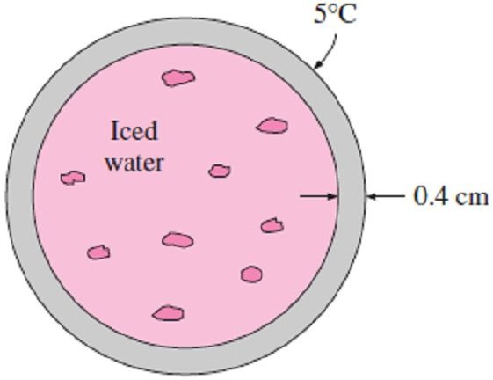
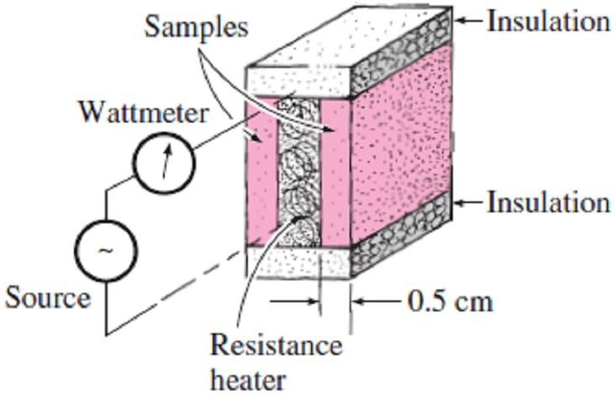
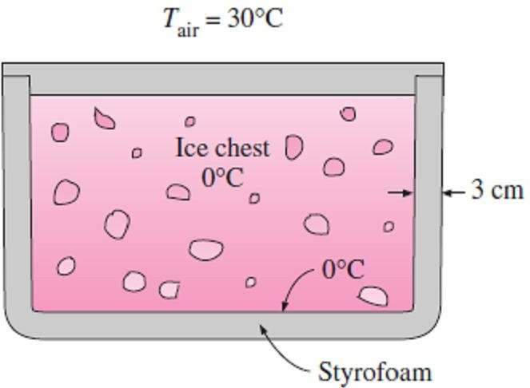
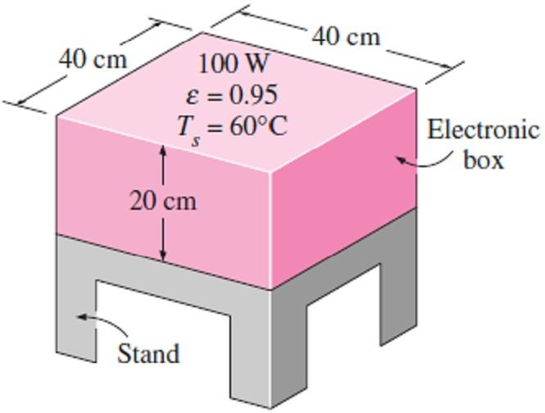
Chapter One
Basics of Heat Transfer
1.12- During an experiment, two 0.5-cm-thick samples 10cm×10cm in size are used. When steady operation is reached, the heater is observed to draw 35W of electric power, and the temperature of each sample is observed to drop from 82C° at the inner surface to 74C° at the outer surface. Determine the thermal conductivity of the material at the average temperature.
Answer: 1.09W/m ·C°
Answers: 12.632kW, 0.038 kg/sec
Prob.(1.16)
1.17- An ice chest whose outer dimensions are 30cm×40cm×40cm is made of 3cm-thick Styrofoam (k = 0.033 W/m ·C°). Initially, the chest is filled with 40kg of ice at 0C°, and the
Prob.(1.12)
inner surface temperature of the ice chest can be taken to be 0C° at all times. The heat of fusion of ice at 0C° is 333.7 kJ/kg, and the surrounding ambient air is at 30C°. Disregarding any heat transfer from the 40cm×40cm base of the ice chest, determine how long it will take for the ice in the chest to melt completely if the outer surfaces of the ice chest are at 8C°.
Answer: 32.7 days
1.13- Consider a person standing in a room maintained at 20C° at all times. The inner surfaces of the walls, floors, and ceiling of the house are observed to be at an average temperature of 12C° in winter and 23C° in summer. Determine the rates of radiation heat transfer between this person and the surrounding surfaces in both summer and winter if the exposed surface area, emissivity, and the average outer surface temperature of the person are 1.6m², 0.95, and 32C°, respectively.
Answers: 84.2 W, 177.2 W 1.14- Hot air at 80C° is blown over a 2m×4m flat surface at 30C°. If the average convection heat transfer coefficient is 55 W/m² ·C°, determine the rate of heat transfer from the air to the plate, in
Prob.(1.17)
1.18- Consider a sealed 20cm-high electronic box whose base dimensions are 40cm×40cm placed in a vacuum chamber. The emissivity of the outer surface of the box is 0.95. If the electronic components in the box dissipate a total of 100 W of power and the outer surface temperature of the box is not to exceed 55C°, determine the temperature at which the surrounding surfaces must be kept if this box is to be cooled by radiation alone. Assume the heat transfer from the bottom surface of the box to the stand to be negligible. Answer: 23.3C°
kW. Answer: 22 kW
1.15- A 50cm-long, 800W electric resistance heating element with diameter 0.5cm and surface temperature 120C° is immersed in 60kg of water initially at 20C°. Determine how long it will take for this heater to raise the water temperature to 80C°. Also, determine the convection heat transfer coefficients at the beginning and at the end of the heating process if the specific heat of water is 4.18 kJ/kg·C°.
Answers: 5.225hr, 1020W/m²·C°, 2550W/m²·C° 1.16- A hollow spherical iron container with outer diameter 20cm and thickness 0.4cm is filled with iced water at 0C°. If the outer surface temperature is 5C°, determine the approximate rate of heat loss from the sphere, in kW, and the rate at which ice melts in the container. The heat
Prob.(1.18)
of fusion of ice at 0C° is 333.7 kJ/kg.
15

